Slide 1
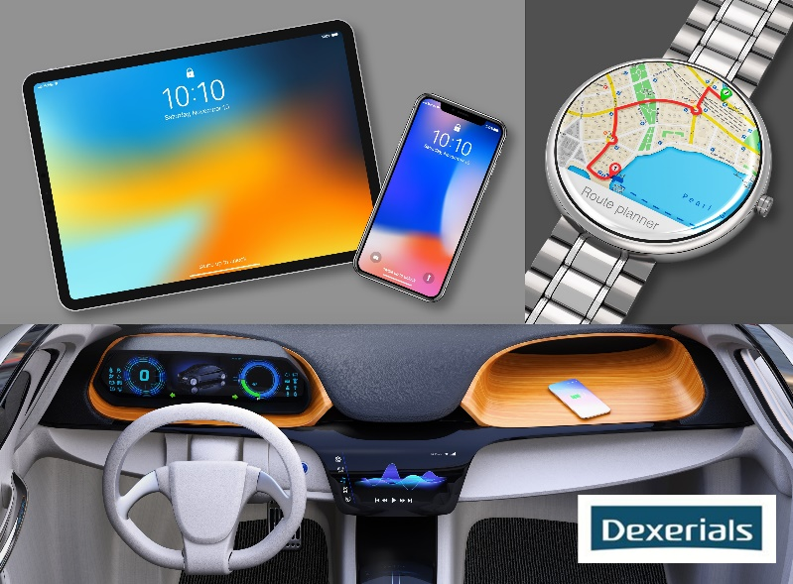
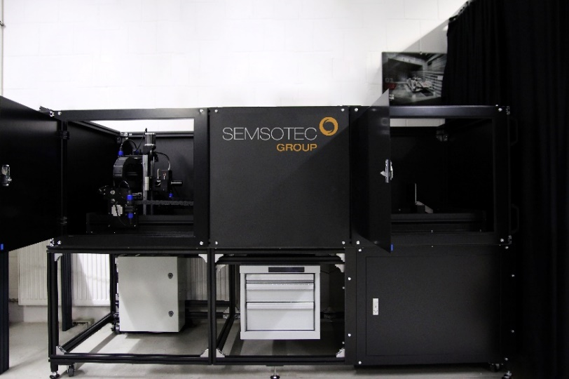
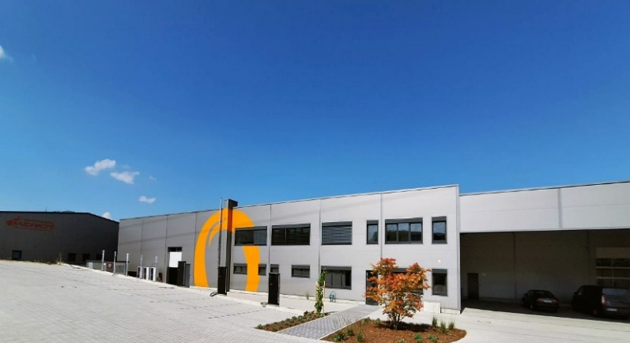
2. DFF Summit Meeting 2023
&
Member Assembly
29th /30th November hosted by
SemsoTec Group & Dexerials B.V.
in Cham (Bavaria) / Germany
HMI Touch Systems - Functionality Meets Complexity
PROGRAM
HOTEL RECOMMENDATIONS / REGISTRATION
Hotel Randsbergerhof (please see Dinner Location)
Parkhotel Cham
Prälat-Wolker-Str. 5
93413 Cham, Germany
https://parkhotel-cham.de
Phone: +49 (0) 9971 395-0
E-Mail: info@parkhotel-cham.de
Gasthof zum Bäckerwirt
Chamerstrasse 5
93466 Chamerau; Germany
https://gasthof-baeckerwirt.de
Phone: +49 (0) 9944 - 763
E-Mail: mail@gasthof-baeckerwirt.de
Hotel Lobmeyer
Marktplatz 6
93426 Roding, Germany
https://hotel-lobmeyer.de
Phone: +49 (0) 9461/91 34 06
E-Mail: info@hotel-lobmeyer.de
!!! REGISTRATION: anita.wedel@displayforum.de
!!! REGISTRATION DEADLINE: by Nov. 8th, 2023
Pictures: Dexerials B.V., SemsoTec Group
LOCATION Nov. 29th
SemsoTec Engineering Services & Products GmbH
Bürgermeister-Schwinghammer-Str. 4
93413 Cham, Germany
Registration Working Group Members: 12:30-13:00
Meetings Working Groups Halo and System Integration: 13:00-15:00
Registration for all Attendees: 14:00
BEGINNING of the SUMMIT MEETING: 15:20
DINNER & Get TOGETHER Nov. 29th
19:00 -22:00
Hotel Randsbergerhof
Randsbergerhofstr. 15 - 19
93413 Cham, Germany
https://www.randsbergerhof.de/
Phone: +49 (0) 9971 / 85770
E-Mail: info@randsbergerhof.de
LOCATION Nov. 30th
Hotel Randsbergerhof (please see above)
Registration for MEMBER ASSEMBLY (only DFF Members): 8:15-8:50
Registration for SUMMIT MEETING (all attendees):
9:30-10:00
BEGINNING of the SUMMIT MEETING: 10:00
END of the SUMMIT MEETING: 16:25
Am Mühlenberg 12Fraunhofer Conference Center
Am Mühlenberg 12
14476 Potsdam
Germany
Pictures: www.iap.fraunhofer.de, www.pixabay.com

Slide 2
12:25-13:15 Group Foto & Networking Lunch
13:15-13:35 Dr. Ingo Rotscholl, TechnoTeam Bildverarbeitung GmbH, Working Group Halo
Presentation of Recent Measurement Results and Conclusions Drawn so far 13:35-13:45 Klaus Wammes, Wammes & Partner GmbH,
Working Group System Integration
Status and Outlook
13:45-13:55 Prof. Dr. Wolfgang Weinhold, ISPA
Proposal to Set Up a Working Group: Human- Factor Tactile Haptik
13:55-14:15 Vladimir Petkow, SMR Automotive Mirrors Stuttgart GmbH CMS Display Development and the Ongoing Challenges and Solutions
14:15-14:35 HoSik Kim, KEIWA Inc.
Optical Products for Automotive Applications
14:35-14:55 PRIde Wang, BenQMaterials Corp.
Optical Decoration Film – The Hidden Display Technology
14:55-15:15 Networking Coffee Break
15:15-15:35 Sadzida Kratz, BMW AG
Complexity in Automotive Touch Application
15:35-16:15 Dr. Michael Schlipf, FPS GmbH
PFAS - Status Quo
Martin Saeckl, Dainkin Chemical Europe GmbH
PFAS - Political Process and Background
16:15-16:25 Hartmut Heske, DFF
Wrap Up and Farewell
Note of caution:
As per § 3.4 of the DFF bylaws (see website)
As DFF meetings are not covered by mutual NDAs, the DFF advises its members as well as every participant at DFF meetings to check and carefully select - in their own interests - all information provided in presentations or discussion of any kind.
Wednesday, November 29th , 2023
12:30-13:00 Registration only for Working Group Members
13:00-15:00 Working Group Meetings
14:00-15:20 Registration for all Attendees
Networking Coffee Reception
DFF Summit Meeting, Part I
15:20-15:30 Joachim Schuhbauer, SemsoTec Group
& Donald Schaffer, Dexerials B.V.
Welcome
15:30-16:00 Joachim Schuhbauer & Donald Schaffer
Introduction of the Cham Site and
Cooperation Scope
16:00-17:30 Joachim Schuhbauer & Donald Schaffer
Factory Tours
19:00-22:00 Dinner and Get Together
Hotel Randsbergerhof
Randsbergerhofstr. 15 - 19
93413 Cham
Thursday, November 30th, 2023
DFF Member Assembly
08:15-08:50 Registration only for DFF Members
09:00-09:30 DFF Member Assembly Dr. Armin Wedel, President DFF,
Fraunhofer IAP
09:30-10:00 Arrival / Registration for all Attendees
Networking Coffee Reception
Thursday, November 30th, 2023
DFF Summit Meeting, Part II
10:00-10:05 Dr. Armin Wedel
Welcome to DFF Summit Meeting, Part II
10:05-10:10 Joachim Schuhbauer, SemsoTec Group
& Donald Schaffer, Dexerials B.V.
Welcome to DFF Summit Meeting, Part II
10:10-10:15 Hartmut Heske, DFF
Meeting Guidelines and Information
10:15-10:30 Joachim Schuhbauer & Donald Schaffer
Company Introductions
10:30-10:55 Michael Stuetzel, SemsoTec Group
An Automatic Measurement System -
Demonstration
10:55-11:05 Dr. Phillip Schau, SMR Automotive Mirrors
Stuttgart GmbH (New Member) Company Introduction
11:05-11:25 Dr. Tonino Greco, Sony Europe B.V.
Sakana Black - Blacker than the Deep Sea
11:25-11:45 Keisuke Tomita, Mitsubishi Gas Chemical Company, Inc.
New Sheet / Film Products for Automotive Applications
11:45-12:05 Prof. Florian Suessl, Berliner Hochschule fuer Technik (BHT)
High Dynamic Range (HDR) – From Image Capturing to Display Output
12:05-12:25 Dr. Kira Fries & Dr. Peter König,
INM-Leibniz-Institut für Neue Materialien gGmbH
Low Volume Production Methods for Optical Clear Capacitive Touch Sensors

